Slide 1

Object detection in surveillance
Submitted by Sujal Maheshwari (2021759) of DS2
Under the guidance of Dr. Pawan Kumar Mishra
This Photo by Unknown Author is licensed under CC BY

Slide 2
Agenda
1
2
3
4
5
Introduction
Methodology
Experimental setup
Result and Analysis
Summary

Slide 3
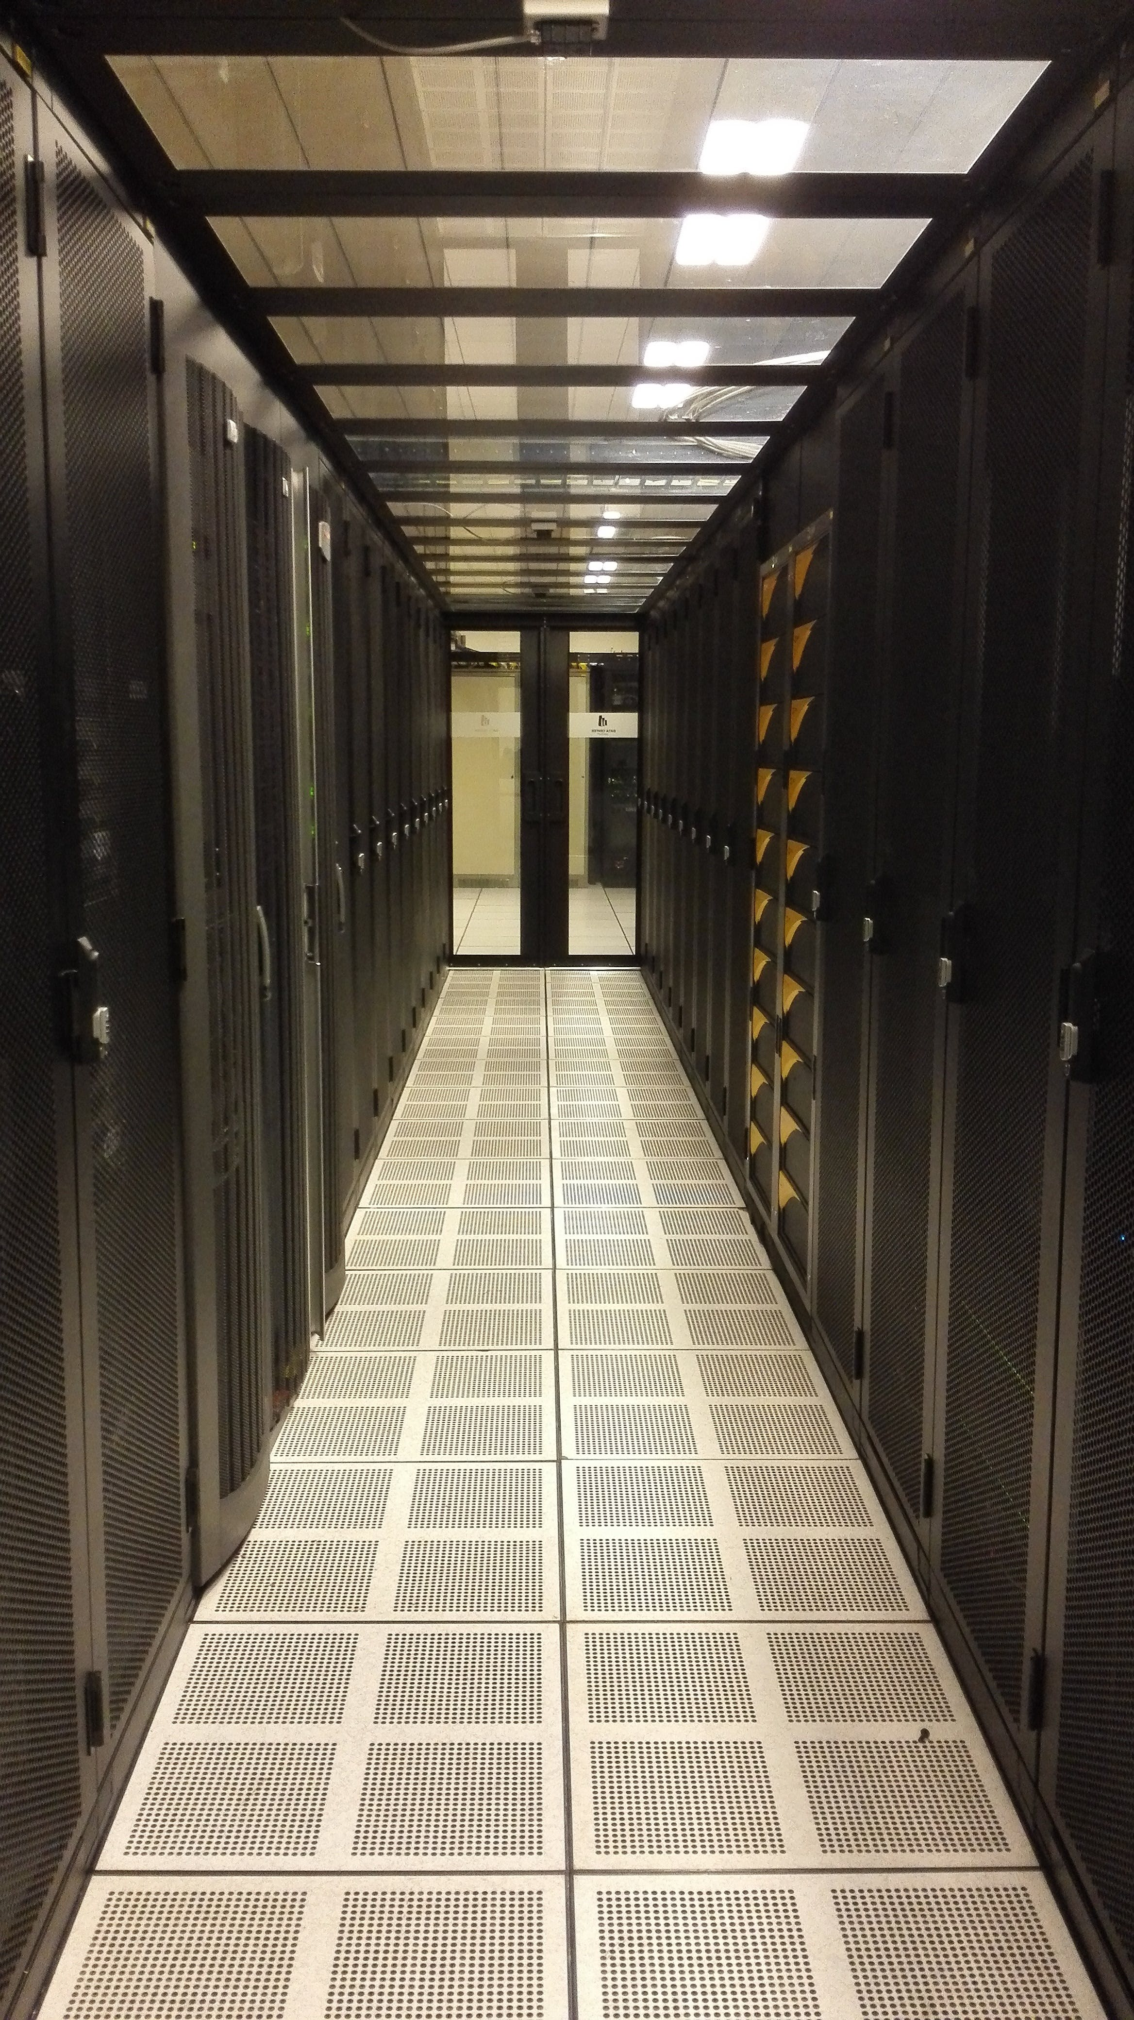
Introduction
The methodology, leveraging OpenCV and NumPy, employs MOG2 background subtraction, feature detection, and contouring for efficient vehicle counting. The system's three-phase architecture combines preprocessing and background subtraction, leading to precise enumeration using a virtual counting line. OpenCV (cv2) handles background subtraction, while NumPy (np) optimizes numerical computations and memory management. This approach establishes a streamlined and effective framework for automated vehicle counting, integrating essential components for accurate analysis of video footage.

Slide 4

Problem statement
The “elephant” in the room

Slide 5
The rapid growth of modern transportation necessitates advanced methods for meticulous traffic monitoring. Current challenges include the need for accurate vehicle counting in video footage to comprehend traffic patterns, inform infrastructure development, and optimize traffic flow. Existing approaches leverage OpenCV and NumPy yet face limitations under variable conditions. The problem is to enhance the robustness of automated vehicle counting systems, addressing factors like lighting variations and occlusions, and exploring additional techniques, such as object detection models and machine learning, to ensure accurate and reliable performance in diverse real-world scenarios.

Slide 6

Methodology
From data to knowledge

Slide 7
The What(s) and How(s)​
Basic overview
System Architecture
Library and Tools
Utilizes OpenCV and NumPy Employs MOG2 background subtraction Includes feature detection and contouring for efficient vehicle counting​ ​
Three-phase structure
Combines preprocessing and background subtraction
Leads to precise enumeration with a virtual counting line​
OpenCV (cv2) for background subtraction
NumPy (np) for numerical computations and memory optimization
VS code’s Environment for ease in developement

Slide 8

Experimental setup
“To perfection do we test” -Aurelius

Slide 9
The value of Work
Dataset Representation:
Parameter Fine-Tuning:
Quantitative Evaluation Metrics:
Specially acquired video with controlled lighting and diverse traffic scenarios.
Balances factors like lane usage, vehicle types, and inter-vehicle spacing.
Adjusted parameters, including min_rect_size, count_line_pos, and offset, for accurate vehicle detection.
Optimized parameters based on video resolution and intended vehicle trajectory.
Utilized metrics such as accuracy, precision, recall, false positive rate (FPR), and false negative rate (FNR).
Metrics provide a comprehensive quantitative assessment of the system's performance in real-world scenarios.

Slide 10

Result & Analysis
"Fructus laboris"
This Photo by Unknown Author is licensed under CC BY-SA

Slide 11
The end of road
Vehicle Detection:
Vehicle Counting:
Performance Metrics:
Effective Background Subtraction: Distinguished moving vehicles, minimizing false positives.
Size-Based Filtering: Reduced false positives, focusing on expected vehicle dimensions.
Robust Count Line: Accurately registered vehicles for reliable counting.
Flexibility with Offset: Accommodated trajectory variations for accuracy in real-world scenarios.
Overall Reliability: Consistently demonstrated reliable detection and counting under variable traffic.
Accuracy and Precision: Quantitative metrics validated system accuracy and precision.
Recall and False Positive Rate: Measured ability to avoid false negatives and minimize false positives.
Optimization Insights: Provided valuable insights for ongoing system optimization in real-world applications.

Slide 12

Summary
The evaluation showcased the system's accurate and reliable vehicle detection and counting in a simulated traffic scenario. Effective modules and parameter adjustments yielded impressive results, indicating the system's potential for real-world applications in traffic management and infrastructure planning, providing valuable insights with precise vehicle data.

